Slide 1
IOT & DIGITAL SOLUTIONS

Slide 2
Iot – Internet of things
The Internet of things (IoT) is a system of interrelated computing devices, mechanical and digital machines, objects, animals or people that are provided with unique identifiers ( UIDs ) and the ability to transfer data over a network without requiring human-to-human or human-to-computer interaction.
Things in IoT usually refers to IoT devices which have unique identities and can perform
Remote Sensing
Actuating
Monitoring capabilities
Devices can exchange data with other connected devices and applications or collect data from other devices and process the data either locally or send the data to centralised servers or cloud based application for performing the data or perform local task within the IoT infrastructure

Slide 3
Functional blocks of iot
An IoT system comprises of a number of functional blocks that provide the system the capabilities for
Identification
Sensing
Actuation
Communication and
Management.

Slide 4
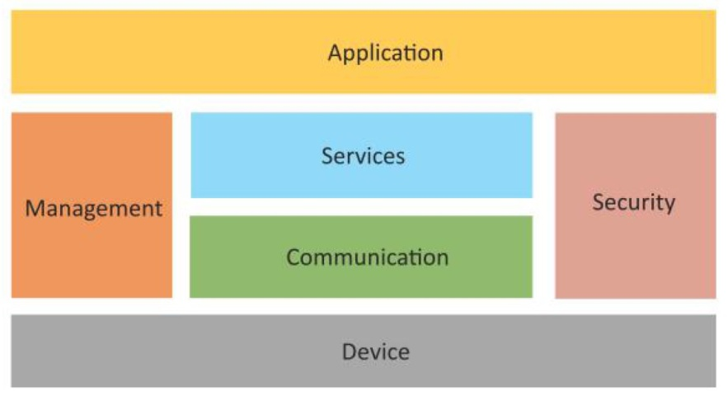
Device: Provides sensing, actuation, monitoring and control functions
Communication: It handles the communication for the IoT System
Services: Services for device monitoring, device control, data publishing and device discovery
Management: It provides various functions to govern the IoT system.
Security: Secures the IoT system and provide functions such as authentication, authorization, message integrity and data security.
Application: It provides an interface that the user can use to control and monitor various aspects of IoT System.

Slide 5
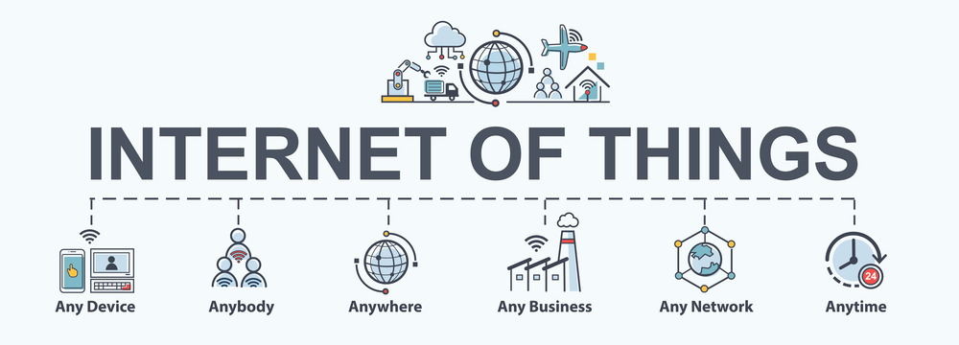
WHY IOT?
Organizations in a variety of industries are using IoT to operate more efficiently, better understand customers to deliver enhanced customer service, improve decision-making and increase the value of the business.
IoT enables machines to complete tedious tasks without human intervention. Companies can automate processes, reduce labor costs, cut down on waste and improve service delivery.
IoT helps make it less expensive to manufacture and deliver goods, and offers transparency into customer transactions.

Slide 6
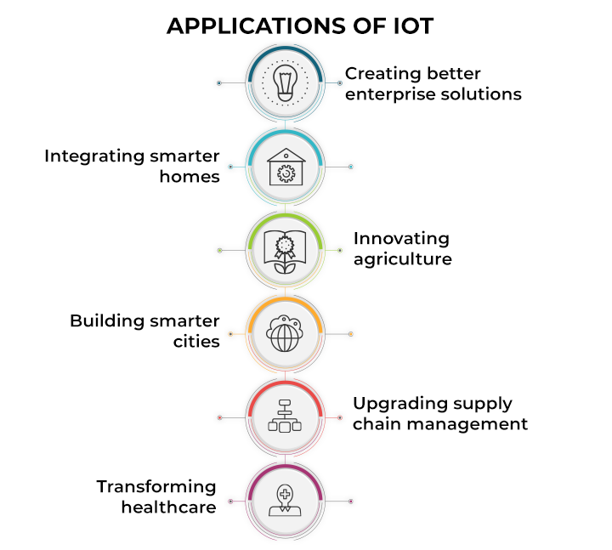

Slide 7
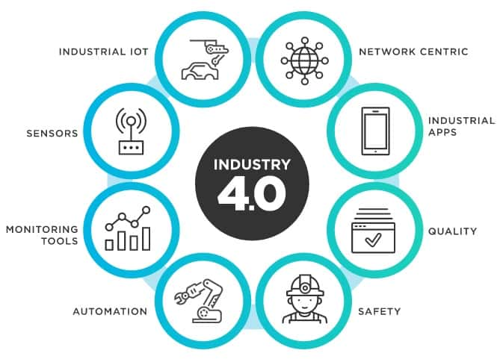
IIOT(industrial iot)
Industrial IoT (IIoT) focusses on the use of cyber-physical systems to monitor the physical factory processes and make data-based automated decisions.
While the physical systems are made the intelligent using IoT, the real-time communication, and cooperation both with each other and with humans is established via the wireless web
IIoT brings in the concept of ‘a connected factory leads to a smart factory’.

Slide 8
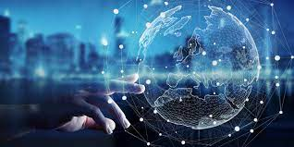
Digital solutions
Digital solutions refer to the use of digital technologies to address specific challenges or provide enhancements in various aspects of life, business, and society.
These solutions leverage digital tools, platforms, and technologies to improve efficiency, communication, and overall performance.
Digital solution is a computerized method of doing something that otherwise would have to be done in another and often slower and more time-involved–way.
To put it another way, we’re talking about using technology to help streamline processes or to solve problems.

Slide 9
Why digital solutions?
Productivity:
Digital solutions are very effective in improving business productivity as they eliminate various factors that affect business productivity.
Digital solutions automate some tasks that would usually require humans, and thus eliminates human errors, and the business operations will run smoothly and swiftly.
Increase in revenues:
Digital solutions will expand business reach and will also helps in meeting targets efficiently, grow our business, and eventually get our desired revenues.
Generating revenue streams is essential, and digital solutions will help in enhancing the businesses.

Slide 10
Why digital solutions?
Customer Service:
Customer service is the critical element of any business because if the customers are not satisfied with the service, the business won’t sustain itself in the current situation.
The digital solutions will allow to offer excellent customer service by providing doorstep facilities, online ordering, online complaints, etc.
Analytics:
Digital solutions helps in collecting the data related to customers habits and business operations.
This relevant data can be easily stored digitally and can be very useful for various analyses.

Slide 11
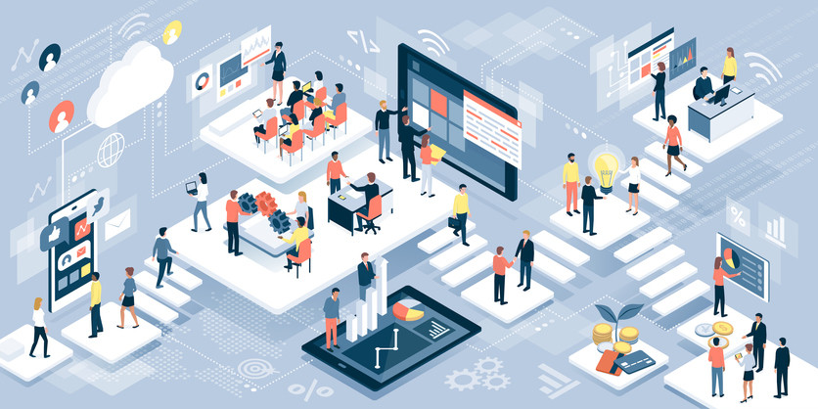
Future prospects
The way the digital revolution has captured audiences’ attention all over the world is considered the next big thing.
People’s response has been excellent, and that is a clear sign of the digital solutions’ success.
The internet and technology are evolving, and as more people get familiar with it, they will realize its importance.
The future will be very bright and astonishing and there is no doubt about the future of digital solutions.

